Slide 1
MACHINE
LEARNING

Slide 2

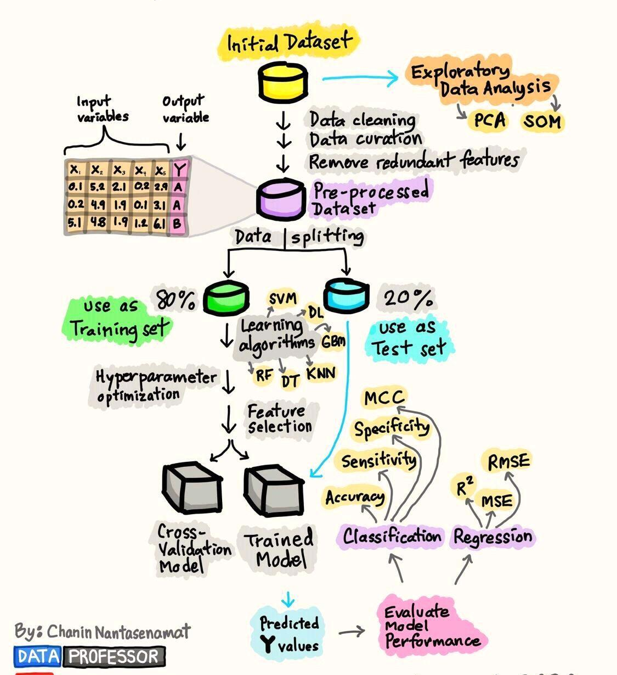


1. THE process
Notes:
Machine learning is a branch of artificial intelligence that focuses on developing algorithms and models capable of learning from data and making predictions or decisions without being explicitly programmed.

Slide 3







Steps
Data Collection
Model Selection
Model Training
Evaluation
Parameter Tuning
Data Pre-processing
Model Deployment
Notes:
It is a systematic process that involves 7 steps (read from slide)

Slide 4





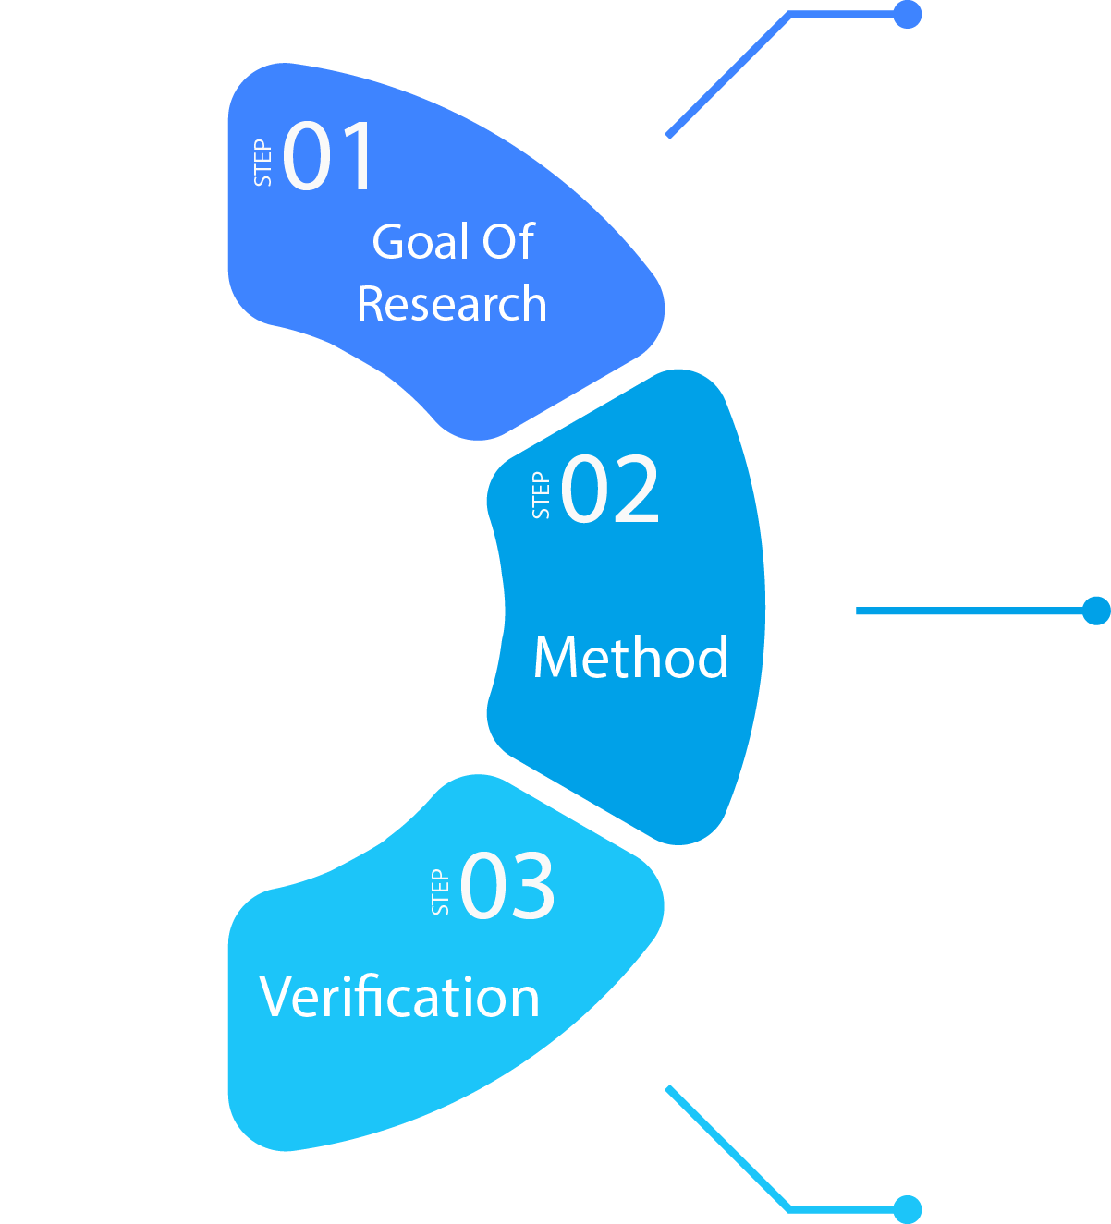







Agriculture
Rainfall data
Temperature data etc.
Crime
cctv images & videos
Forensic data
Education
Administrative data
Performance data
Healthcare
Billing and claims record
Clinical trials data
IoT Sensors
Social Media Tracking
Surveys
Online Tracking
Verify data source
Check validity and reliability
Notes:
Data collection
The first step in machine learning process is to collect relevant data, this can involve collecting data from various sources. The collected data should then be verified before using it.

Slide 5

2. DATA PRE-PROCESSING
Notes:
Data pre-processing
Once the data is collected, it often requires pre-processing. Data pre-processing ensures that the data is reliable, consistent and ready for model training.

Slide 6
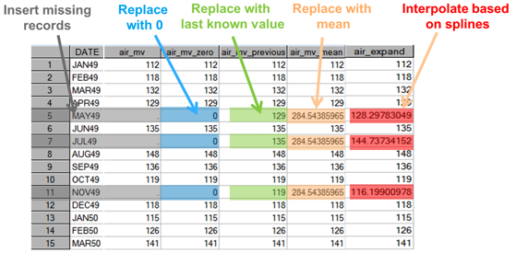
1. Impute Missing Values :
Figure 1
Tools:
R, Python pandas etc
Notes:
Data pre-processing involves
Imputing missing values. Most common ways include imputing either zero, constant, mean, median, or the most frequently occurring value.

Slide 7
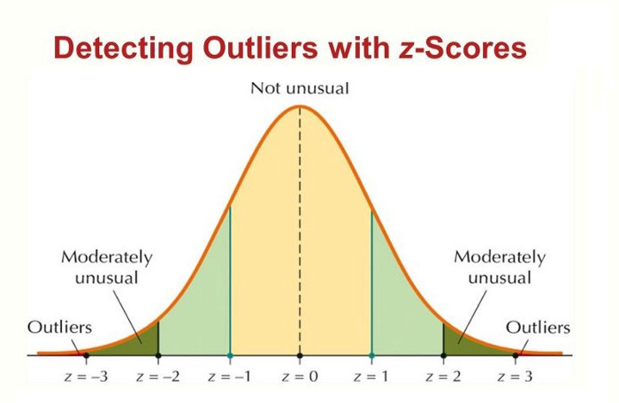
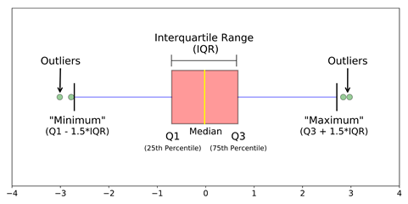
2. Handle Outliers:
Detect:
Figure 2
Figure 3
Handle:
Quantile based flooring or capping / Remove
Mean or Median imputation / Remove
Notes:
Handling outliers. Outliers are detected by Boxplot or z-score. Then the outliers are either replaced with reasonable values or removed completely

Slide 8
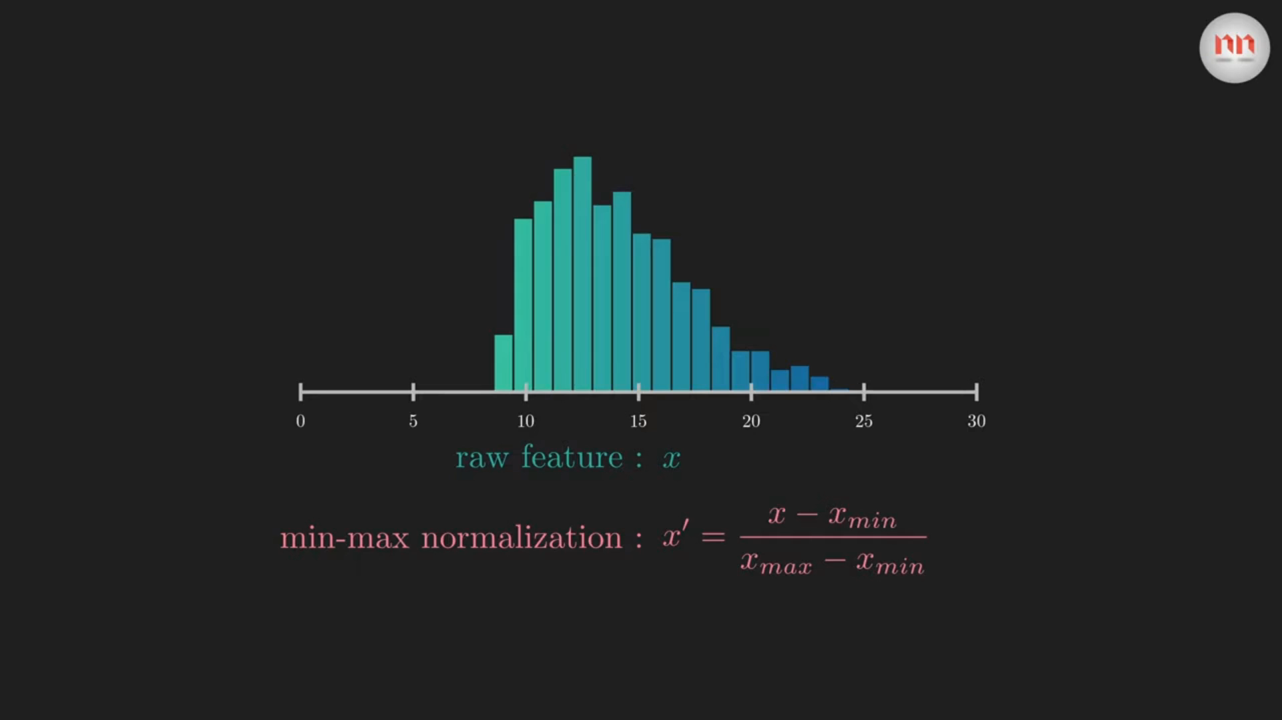
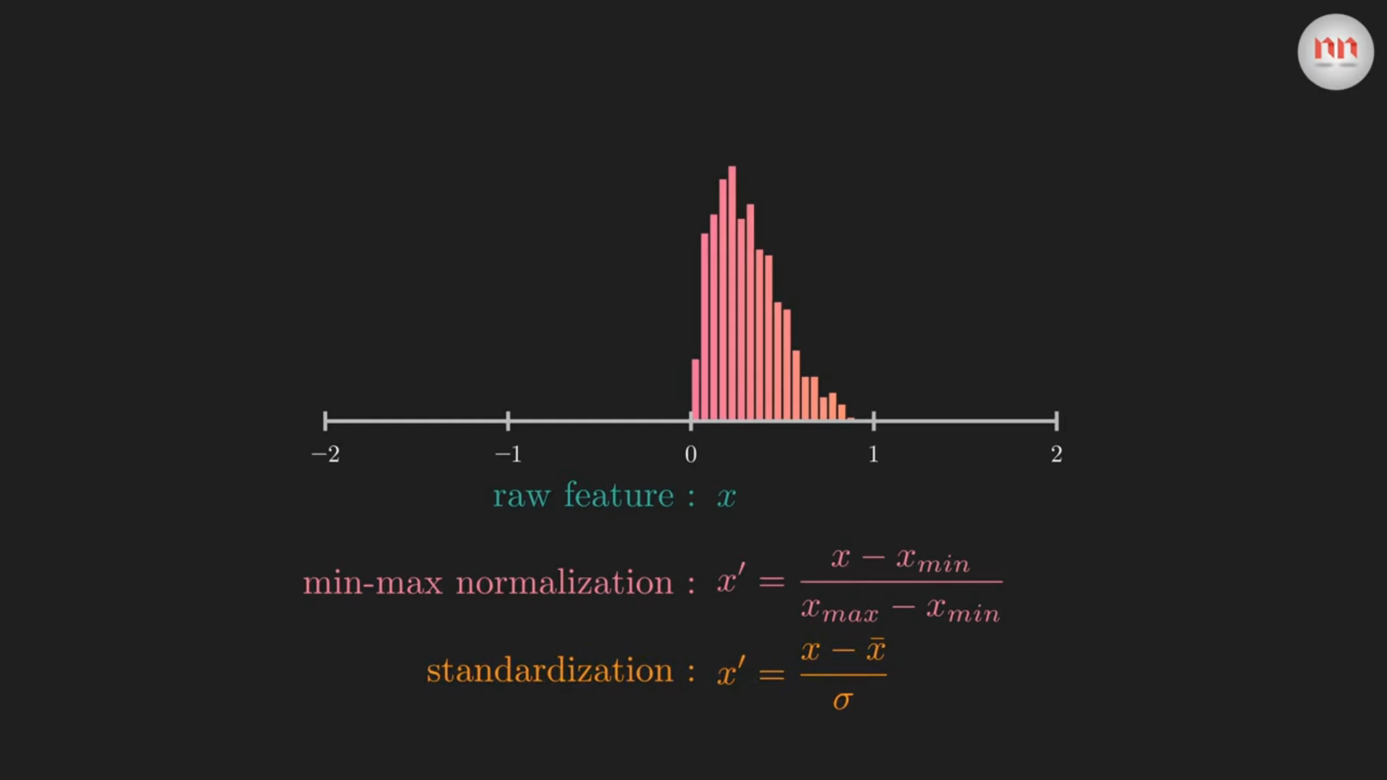
3. Scale Features
For:
Distance based algorithms
Gradient descent based algorithms
Ways:
Standardization
Normalization
Clip 1
Clip 2
Notes:
Scaling features. Feature scaling helps the algorithm can handle different scales and units, prevent numerical instability and enable regularization.
Feature scaling is usually done to distance based algorithms and gradient descent-based algorithms.
Standardization and normalization are ways to scale features.

Slide 9
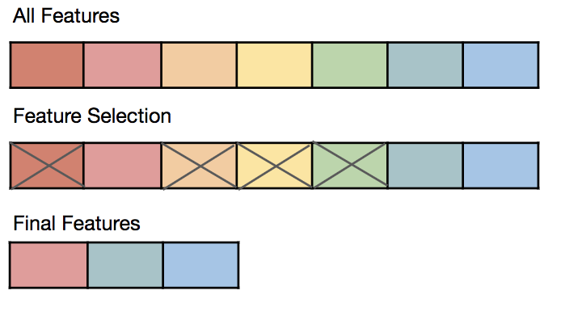
4. Select Features
To
Reduce Dimensionality
Reduce overfitting
Reduce training time
Ways
PCA
Univariate feature selection
Correlation based feature selection
Figure 4
Notes:
Selecting Features. The goal of feature selection is to improve the performance of the model by reducing the dimensionality of the data and focusing on the most informative and discriminative features.

Slide 10
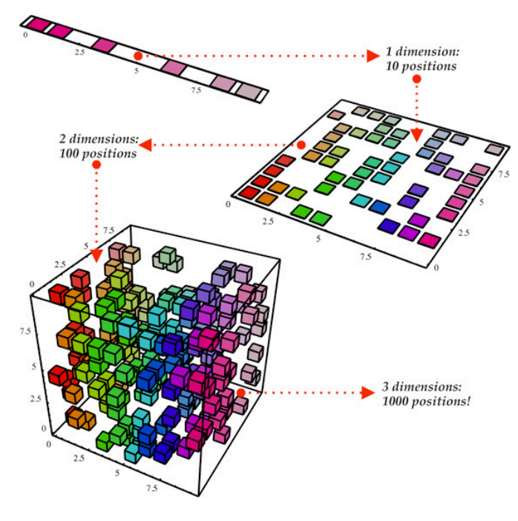
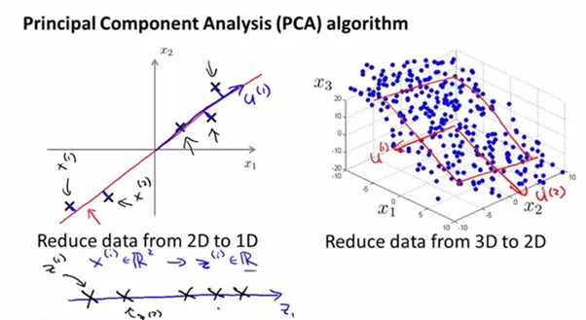
Dimensionality Reduction
Principle Component Analysis
Figure 6
Figure 5
Notes:
PCA – principle component analysis, univariate feature selection and correlation-based feature selection are the common methods.

Slide 11
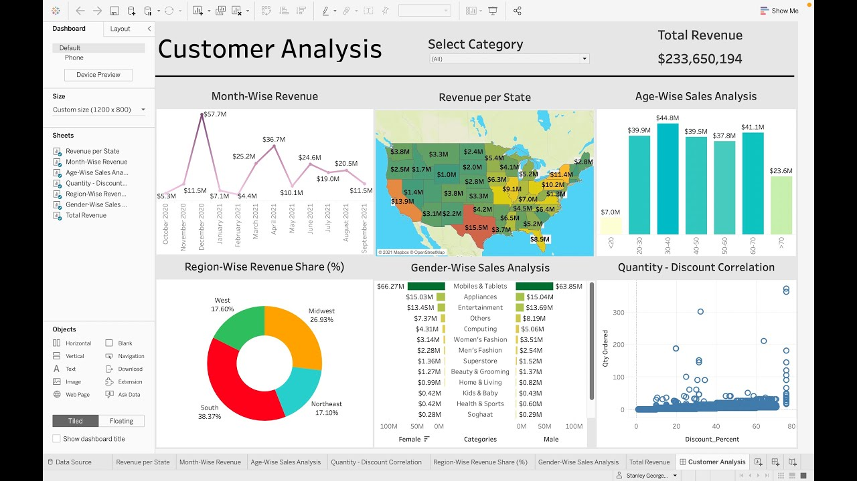
5. Visualize
Figure 7
Notes:
Visualizing the data. visual representations of the data are created to gain insights, understand patterns and make informed decisions.

Slide 12

3. MODEL SELECTION
Notes:
Model selection is the process of choosing appropriate machine learning algorithm for the given data. It involves evaluating and comparing different models to determine which performs best on a specific task or a specific dataset.

Slide 13

Identify problem type:
Classification
Prediction
Size and Complexity:
Greater – Choose complex models
Lesser – Choose simple models
Interpretability:
Outputs should be easier to understand
Notes:
Some key considerations include identifying problem type classification or regression, size and complexity of the task and interpretability of the algorithm.

Slide 14

4. MODEL
TRAINING
Notes:
Model Training. Here the chosen algorithm or model is trained using the pre-processed data.

Slide 15





Iterative Process
Use the model on the training data
Decrease errors and increase accuracy
Train-test split the data
Evaluate the model
Steps
Notes:
It is an iterative process where the data is first split into training and testing batches, the training batch is used on the model and the testing batch is used to evaluate the model. It is in this process the model learns the patterns and relationships within the data.

Slide 16

5. MODEL EVALUATION
Notes:
Model Evaluation. After the model is trained, it needs to be evaluated to assess its performance and generalization ability. Evaluation helps us understand if the model can make accurate predictions. There are evaluation metrics to measure the model performance.

Slide 17
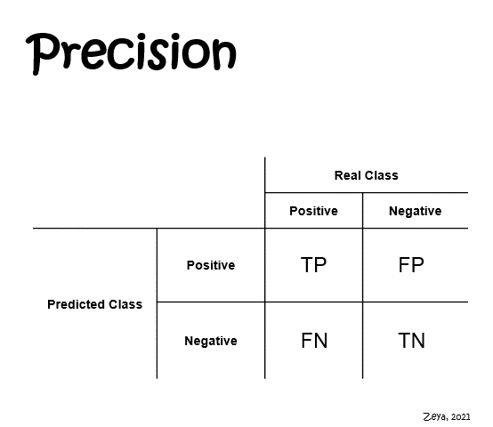
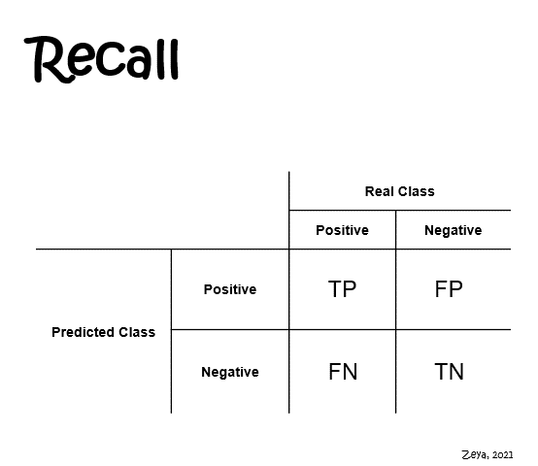
Accuracy, Precision and Recall
Accuracy = No. of correct predictions (TP + TN)
Total no. of predictions (TP + TN + FP + FN)
Clip 3
Clip 4
Notes:
Accuracy precision and recall. Accuracy is the ratio which tells the correct number of predictions amongst all the other predictions. Accuracy is not always a reliable metric hence precision and recall is used. Precision is, of all positive predictions how many are really positive, and recall is, of all the real positive cases how many are predicted positive.

Slide 18
2. F1 score
It is the harmonic mean of precision and recall, providing a balanced evaluation of a model's performance.
In simple terms, the F1 score tells us how well a model performs in correctly identifying positive instances while avoiding false positives
F1 score = 2 * Precision * Recall
Precision + Recall
Notes:
F1 score (read from slide)

Slide 19
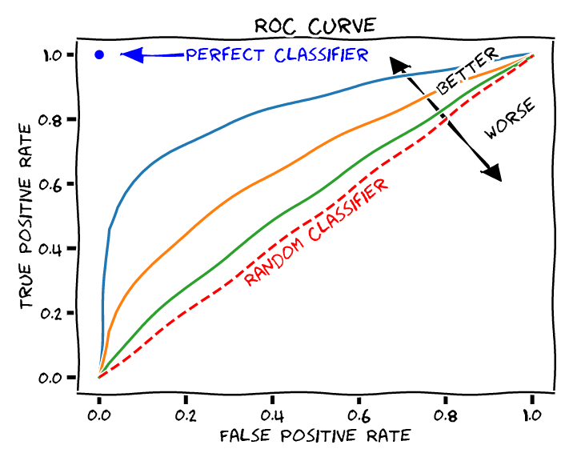
3. AUC – ROC Curve
Area under curve of Receiver operating characteristic curve
Hence greater the area under the curve, better the model’s performance
Figure 8
Notes:
AUC-ROC curve. It provides a comprehensive measurement of a classification model’s performance and is less sensitive to class imbalance problem. A curve that is closer to the top left corner i.e., larger area under curve indicates better overall performance, while a curve that is closer to diagonal line represents a weaker model.

Slide 20
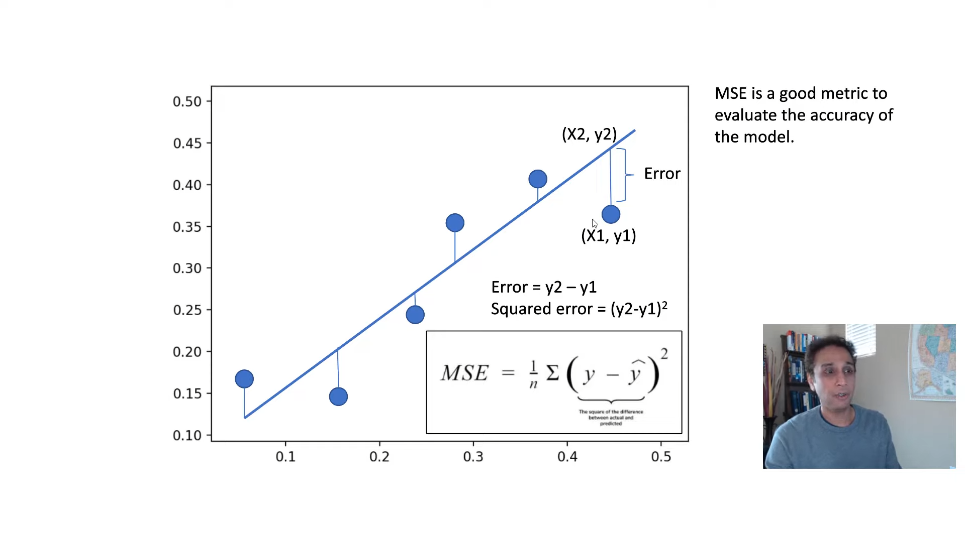
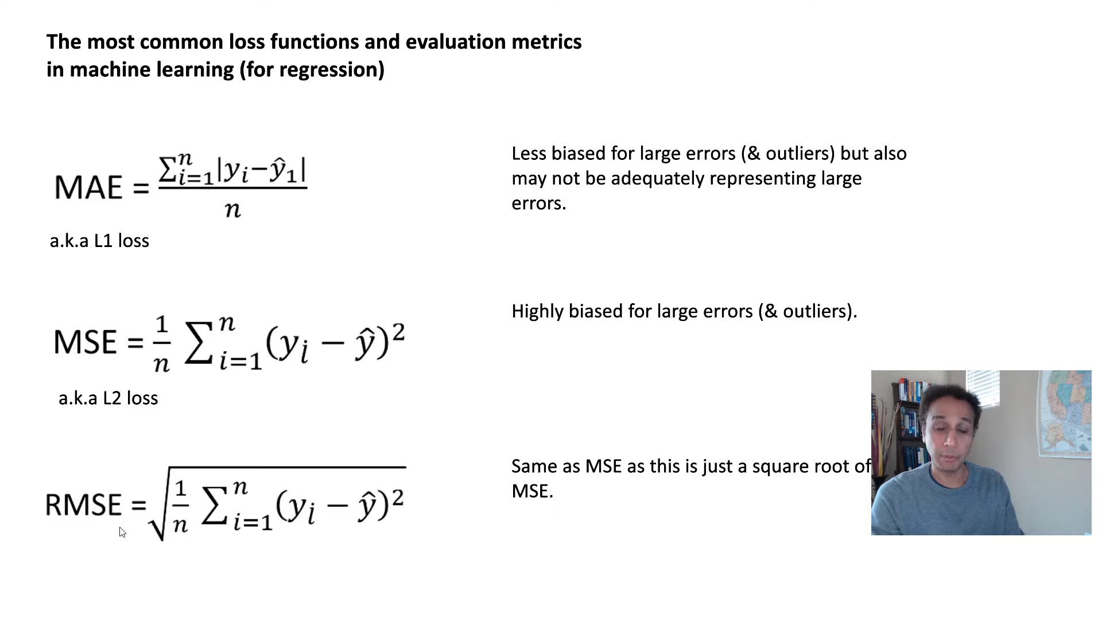
c
Mean absolute error, Mean squared error and Root mean squared error
Figure 9
Figure 10
Notes:
Mean Absolute Error (MAE), Mean Squared Error (MSE), and Root Mean Squared Error (RMSE) are commonly used evaluation metrics for regression models. They provide a measurement of the deviation between the predicted values and the actual values.

Slide 21
2. R² Score and Adjusted R²
R² = 1 − sum squared regression (SSR)
R-squared tells us how well the independent variables in a regression model explain the variation in the dependent variable
total sum of squares (SST)
= 1 − ∑(actual y_{i} – predicted y_{i})²
∑(actual y_{i} – mean(y_{i}))²
R² _{adj} = 1 − (1 − R²)(n − 1)
Adjusted R-squared (adjusted R^2) is a modified version of R-squared that takes into account the number of independent variables and the sample size
(n – k – 1)
Where n = no. of points in data
k = no. of independent regressors
Notes:
r-square and adjusted r-square They are commonly used metrics for evaluating the goodness-of-fit of regression models. They provide a measure of how well the model explains the variability in the dependent variable. (read from slide)

Slide 22
For Regression
Mean absolute error
Root mean squared error
For Classification
Accuracy score
Precision and Recall
Mean squared error
R - squared
Adjusted R - squared
Confusion matrix
F1 – score
AUC – ROC Curve
EVALUATION
TECHNIQUES
Notes:
The evaluation metrics can be classified into two types, for regression and fore classification. For regression models (from slide) are used and for classification models (from slide) are used.

Slide 23

6. PARAMETER
TUNING
Notes:
Parameter Tuning. Also known as hyperparameter tuning, is the process of selecting optimal values for hyperparameters of the machine learning algorithm. They control the behaviour of the learning algorithm and can have a significant impact on the performance of the model.

Slide 24
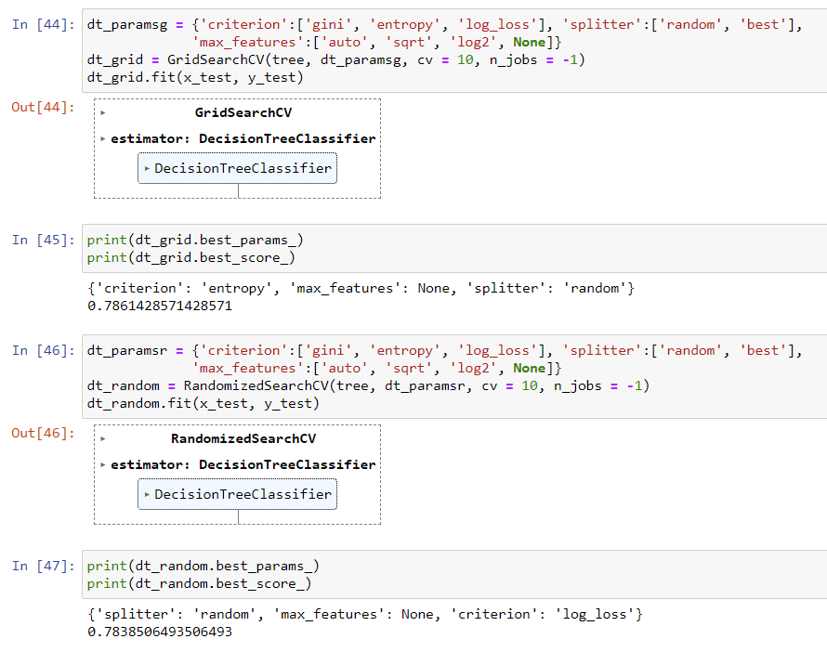
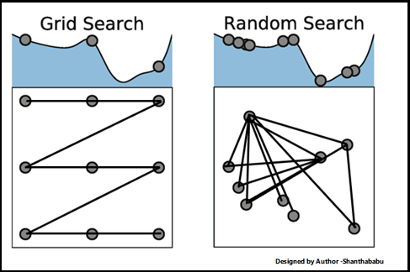
Grid Search and Random search
Figure 11
Notes:
Grid search and randomized search
Grid search is a systematic approach to hyperparameter tuning that involves exhaustively searching through a predefined set of hyperparameter values.
Randomized search is a more flexible and efficient approach to hyperparameter tuning. Instead of exhaustively searching through all possible combinations, randomized search randomly samples a specified number of combinations from a predefined distribution of hyperparameter values.

Slide 25
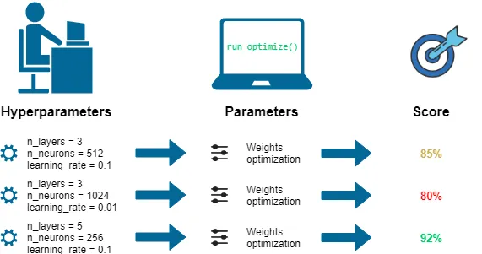
Hyperparameter Tuning or Optimizations for more complex algorithms
Figure 12
Notes:
For more complex algorithms like artificial neural networks and convolutional neural networks. The parameters are not fixed and have varying ranges. For optimizing these parameters, we use complex optimization techniques.

Slide 26
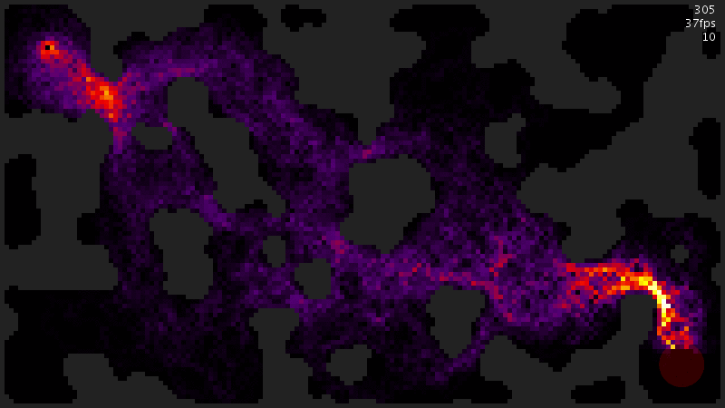
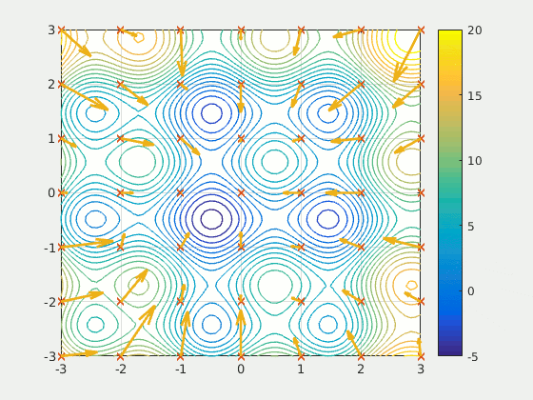
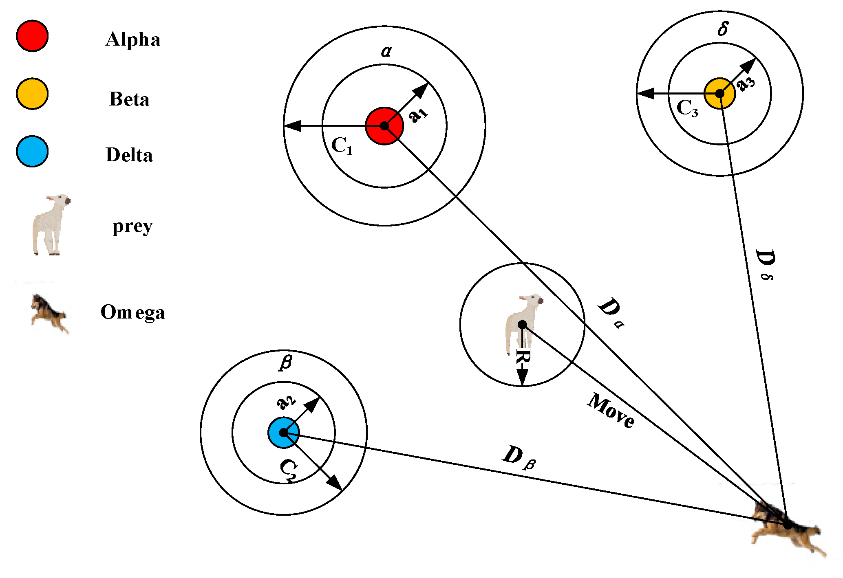
Optimization Techniques:
Ant colony optimization
Grey wolf optimization
Particle swarm optimization
Figure 13
Figure 15
Figure 14
Notes:
Ant Colony Optimization (ACO) is a metaheuristic optimization algorithm inspired by the behaviour of ants searching for food. It is primarily used for solving combinatorial optimization problems. It is used for its efficiency, adaptability, global search and parallelism
Particle Swarm optimization PSO is inspired by the social behavior of bird flocking or fish schooling. It is used to solve optimization problems, especially continuous and multi-dimensional optimization problems.
Grey wolf optimization GWO is inspired by the social behavior and hunting mechanism of grey wolves. It is used to solve optimization problems and has gained popularity in various domains. It is used for exploration and exploitation characteristic and faster convergence speed.

Slide 27

7. MODEL
DEPLOYMENT
Notes:
Model Deployment. Once the model has been evaluated and meets the desired performance criteria, it is ready for deployment. Model deployment involves integrating the trained model into a production environment, where it can be used to make predictions on new, unseen data. This can be done through APIs, web applications, or other means, depending on the specific use case.

Slide 28
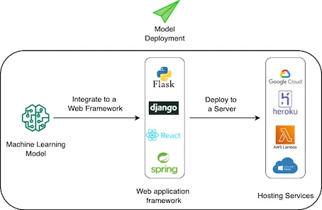
Machine Learning Model Deployment:
Notes:
A simple process to deploy a machine learning model. Integrate it to a web framework and deploy it to a server.

Slide 29
REFERENCES
Figure 1: https://pubsonline.informs.org/do/10.1287/LYTX.2014.01.05/full/impute.png
Figure 2: https://editor.analyticsvidhya.com/uploads/39536outlierdetection.png
Figure 3: https://editor.analyticsvidhya.com/uploads/12311IQR.png
Figure 4: https://miro.medium.com/max/694/0*gz5XuPZfN0wAi66I
Figure 5: https://d33wubrfki0l68.cloudfront.net/01316408b30cff093b186ee7194637d793e62f27/309a4/images/dimensionality-reduction-1.png
Figure 6: https://miro.medium.com/v2/resize:fit:750/format:webp/1*T3Jijdtg0lcS3pP4ZFaMkw.png
Figure 7: https://i.ytimg.com/vi/_qReGTOrKTk/maxresdefault.jpg
Figure 8: https://sefiks.com/2020/12/10/a-gentle-introduction-to-roc-curve-and-auc/
Figure 9: https://youtu.be/fk7bzKFDmk8
Figure 10: https://youtu.be/fk7bzKFDmk8

Slide 30
Figure 11: https://www.analyticsvidhya.com/blog/2022/02/a-comprehensive-guide-on-hyperparameter-tuning-and-its-techniques/
Figure 12: https://towardsdatascience.com/hyperparameters-optimization-526348bb8e2d
Figure 13: https://github.com/reaxis/ants
Figure 14: https://www.mdpi.com/2073-8994/11/12/1470
Figure 15: https://commons.wikimedia.org/wiki/File:ParticleSwarmArrowsAnimation.gif
Figure 16: https://towardsdatascience.com/deploying-machine-learning-models-with-heroku-4dec1df87f71
Clip 1: https://youtu.be/sxEqtjLC0aM
Clip 2: https://youtu.be/sxEqtjLC0aM
Clip 3: https://towardsdatascience.com/precision-and-recall-made-simple-afb5e098970f
Clip 4: https://towardsdatascience.com/precision-and-recall-made-simple-afb5e098970f

